Slide 1
Domo’s Jupyter Workspaces: The Intersection between Data Science and Business Intelligence
Kendall Ruber – Domo Chicago Connections Tour. 2022.

Slide 2

About Me
Data Scientist who came from a Business Intelligence background
I’ve worked in the Utility and Quick Service Restaurant industries
New to Chicago! I was born and raised in Kentucky.
Been using Domo for roughly 1 year
Favorite Domo visual: World Map
Favorite Domo feature: The number and variety of connectors
Notes:
Before getting started, I would like to provide a background about myself------
Transition

Slide 3
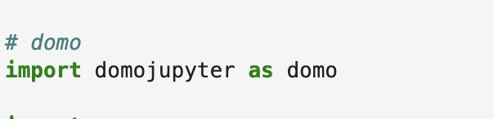
What is Jupyter Workspaces?
A way to use Python directly inside of Domo, without having to leave the platform.
Use an existing dataset or create one from scratch
Perform data cleaning and modeling
Set up your notebook on a scheduled refresh
Save your dataframe as a new or updated dataset to Domo
Elevate your insights and visuals!
Notes:
The functionality I’d like to discuss today is Jupyter Workspaces. Before we get more into today’s use case, I’d like to provide a background for what JW is for those of you who may not have heard of it yet. This functionality was demonstrated at Domopalooza earlier this year, and has been rolled out to non-Beta customers within the past month or so – so, if you haven’t heard of it until now, that’s why!
What Jupyter workspaces does it that it is a way to use Python directly inside of Domo, without having to ever leave the platform. As I metioned earlier, I am a Business Intelligence Analyst turned Data Scientist – so this tool is PERFECT for users like me who want to combine BI with the advantages of open source programming langauges like Python.
Start with an existing Domo dataset or create your own from scratch – and then perform your data cleansing and modeling as you normally would in a Jupyter notebook by importing the domo Jupyter package.

Slide 4
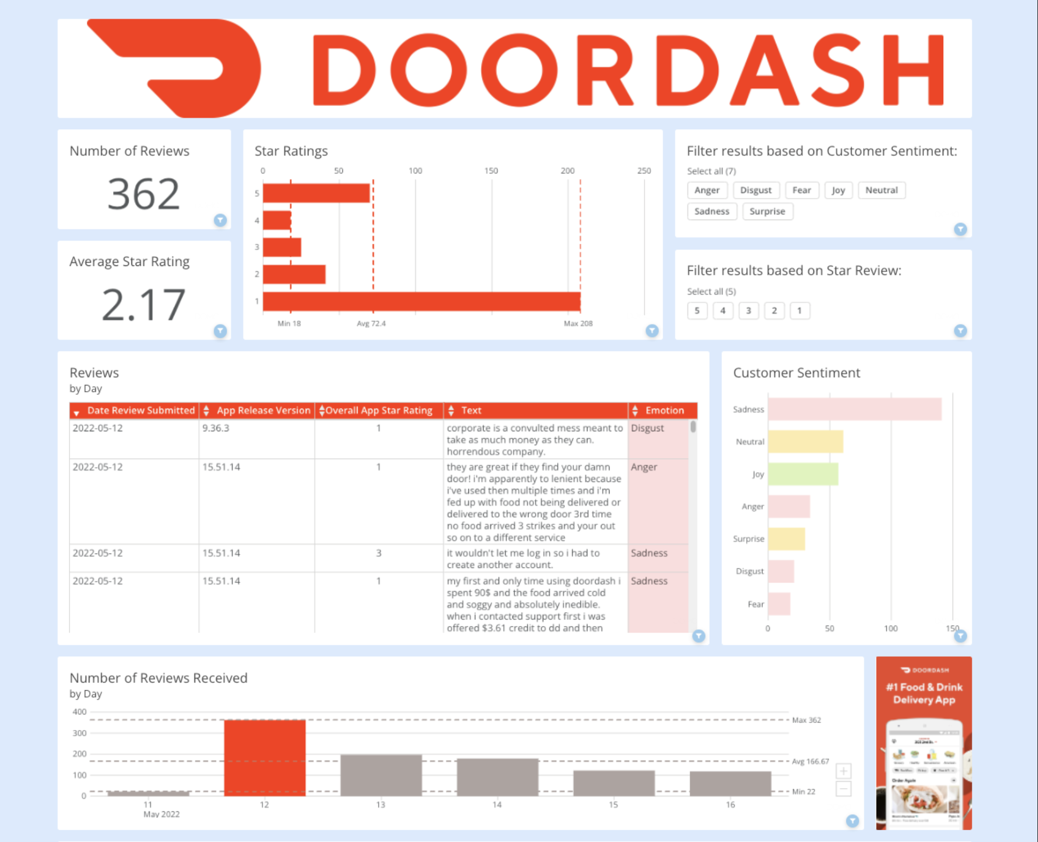


Use Case: Using NLP to analyze customer reviews
Notes:
For the rest of the presentation, I will walk you all through a live demo of a personal project I made analyzing DoorDash’s app stores reviews from customers using an NLP model from Hugging Face, which is a hub for various Machine Learning and Artificial Intelligence models

Slide 5
Live Demo!
Notes:
Open dashboard and show various fields collected and visuals used
Show jup notebook – make sure you get this up and Started first!
Show terminal and how to set up notebook
Walk through notebook – highlight that this dataset is from scratch, although you can import existing domo datasets
Show write back to domo as a dataset
Show scheduled refresh
Show domo dataset
Show history pass/fail
Any questions?

Slide 6
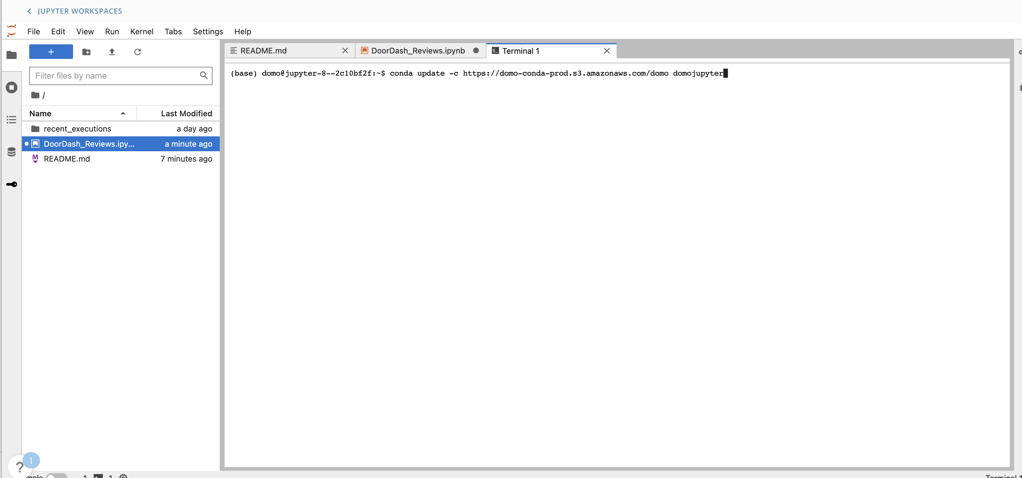
Getting Started: Creating your environment
Notes:
(Below slides in case internet connection is not good and notebook won’t adequately start) Getting Started
The first step to any data science project is setting up your environment and importing necessary packages. Just like on your computer, you can create an environment for each Jupyter workspace within the Terminal. On the left hand side, you can see that there is also a README file that is ready for use to provide a summary of the project and documentation for future readers.

Slide 7
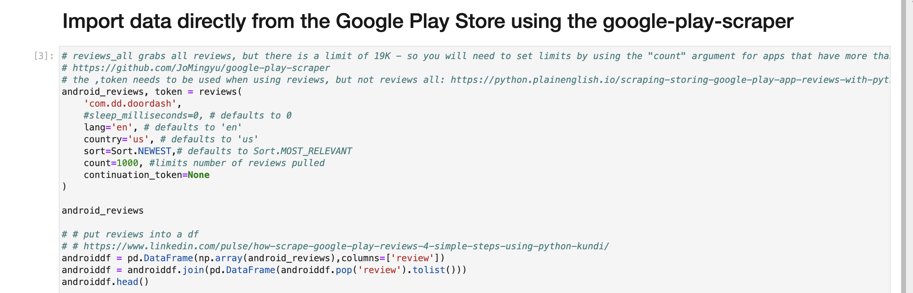
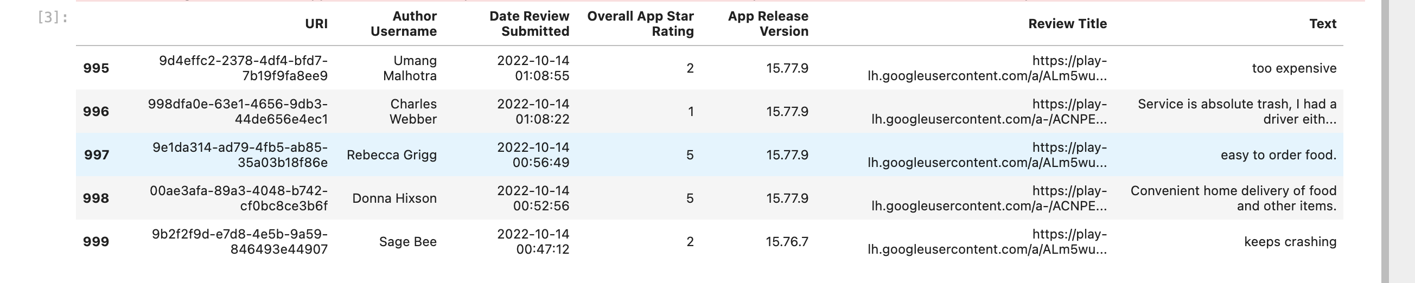
Notes:
Data import
Here I import the data using the google-play-scraper. I want to highlight that this dataset is created from scratch, although you can import existing domo datasets here as well

Slide 8
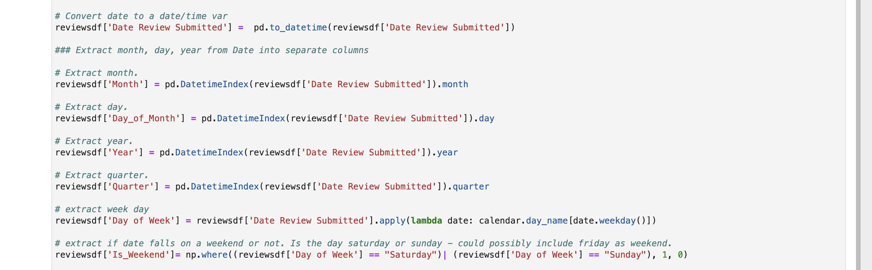
Notes:
Perform manipulations as you normally would in python

Slide 9
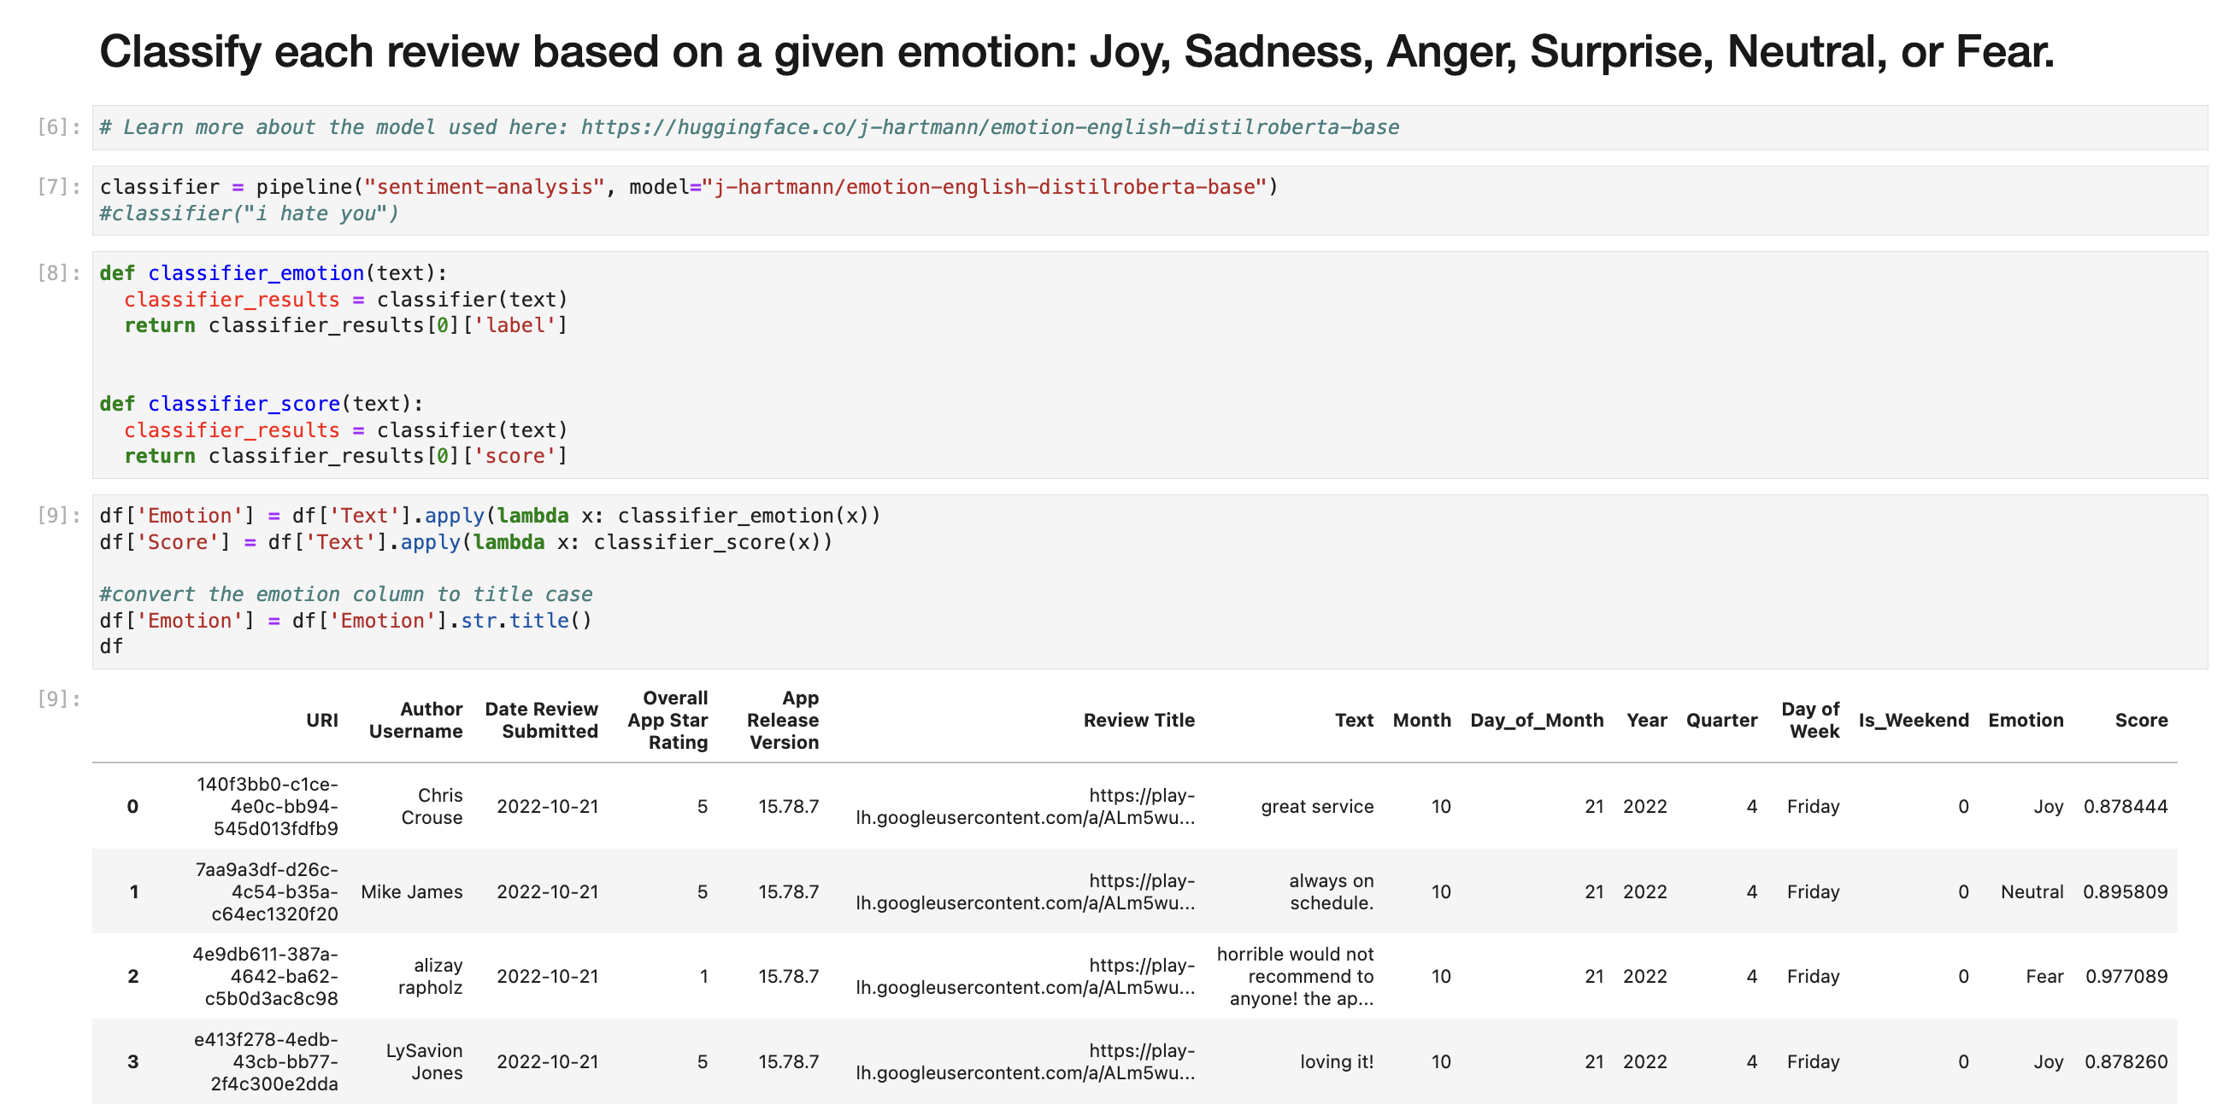
Notes:
Apply the NLP model.
One of the advantages of Hugging Face is that many of their models can be implemented using only a few lines of code. The model I’m using here is DISTIL ROBERTA BASE, but Hugging Face hosts numerous other models that may better fit your particular use case. As you can see in the Emotion column on the far right, each review is analyzed and a specific emotion is applied.

Slide 10
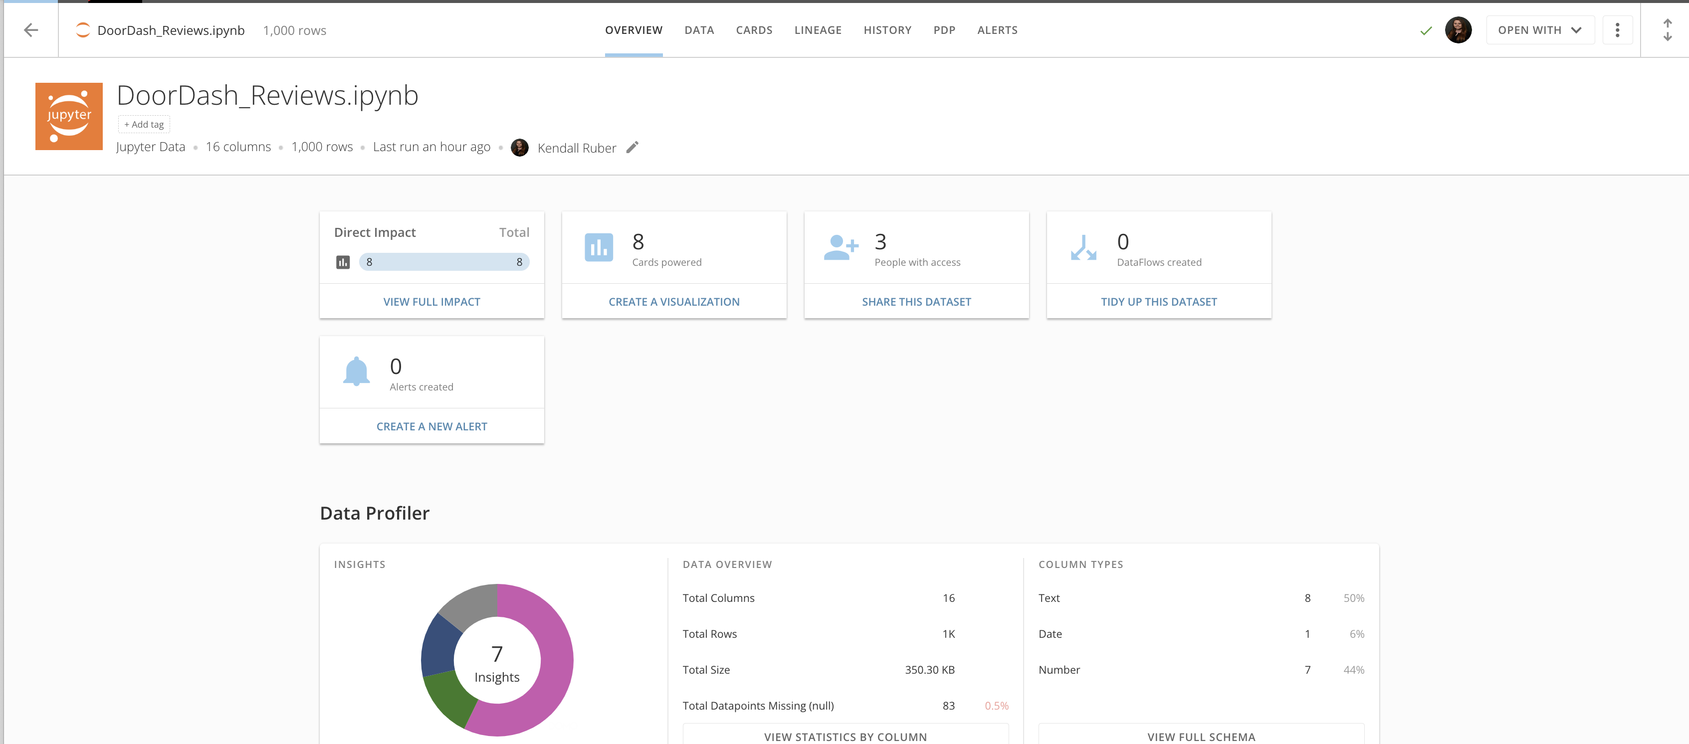
Notes:
Write back to domo
To write this dataset back to Domo as a dataset, use domo jupyter’s write_dataframe command.

Slide 11
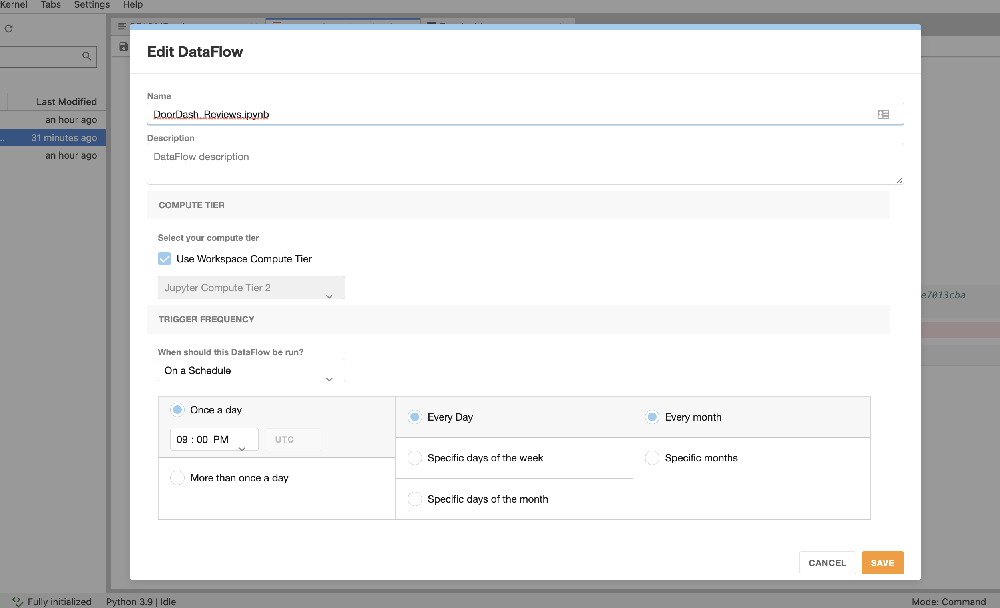
Notes:
BONUS: Schedule your notebook to refresh on a recurring basis
And last, but certainly not least, like any domo dataset, you can set up your jupyter notebook to refresh on a recurring basis, so you always have the most up to date insights!
Here, you go into the Edit DataFlow component and can set your notebook to refresh on a weekly, monthly, or daily basis, or even refresh multiple times per day if you’d like. To me, this is one of the most impactful benefits of the tool – I have not seen similar functionality present in Domo’s competitors.

Slide 12
Questions?
Additional Resources:
Underlying Code and PowerPoint Slides:
https://github.com/kendall-bug/DoorDash_Reviews
Hugging Face Model:
https://huggingface.co/j-hartmann/emotion-english-distilroberta-base
Instructions for how to set up your own Jupyter Workspace:
https://domohelp.domo.com/hc/en-us/articles/360047400753-Jupyter-Workspaces-Beta-
https://domopalooza2022.brandlive.com/home/en/session/10a98144-9651-11ec-95c3-9349e7013cba

